Slide 1
Data Science Training Trees
Oct 26th 2016

Slide 2
Machine Learning
Today we look at trees .
Trees is a non-parametric method, as opposed to regression, ridge, lasoo which are parametric methods. They assume a form to the data, trees do not assume any form, so is good for complex shapes.
See the book on Box or free online An Introduction to Statistical Learning, with Applications in R. Gareth James, Daniela Witten, Trevor Hastie and Robert Tibshirani

Slide 3

Ainator

Slide 4
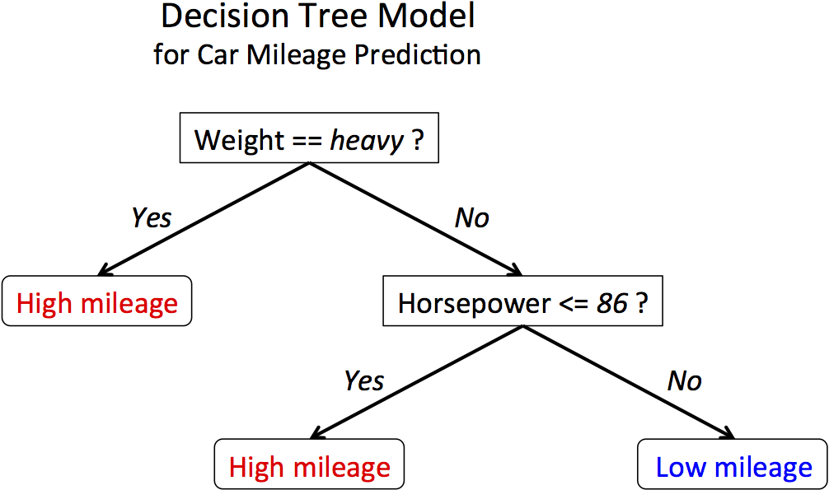
The basics

Slide 5
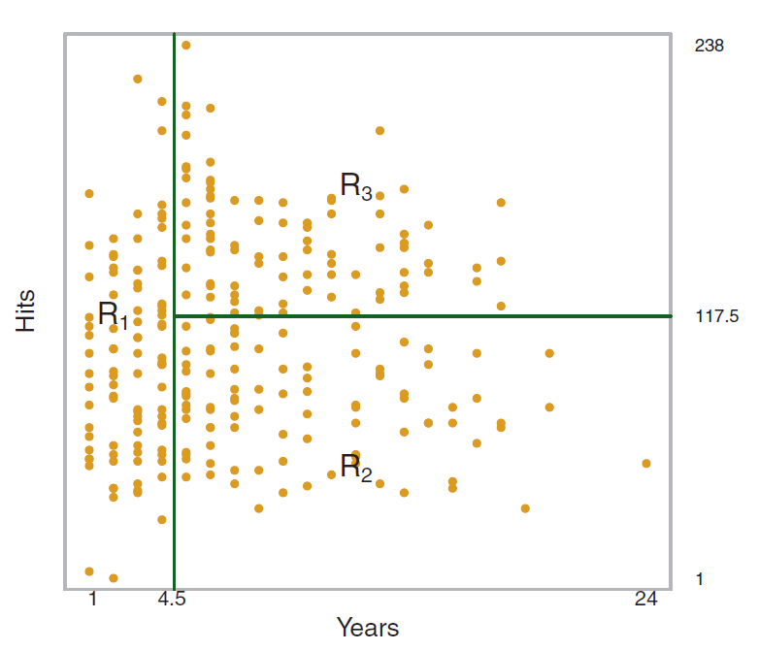
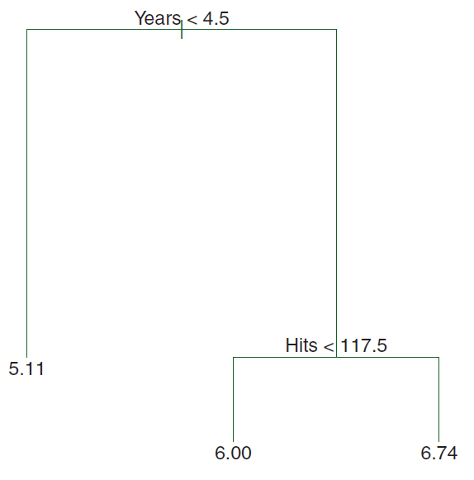
Trees
Predict Salary in Hitters Data
Salary
Blue – avg left is 4 salary ; avg on right is 7 salary - RMSE 4.5
Green – avg left is 4.8 salary ; avg on right is 6.5 salary - RMSE 3.8
Red – avg left is 5 salary ; avg on right is 6 salary - RMSE 4.9

Slide 6

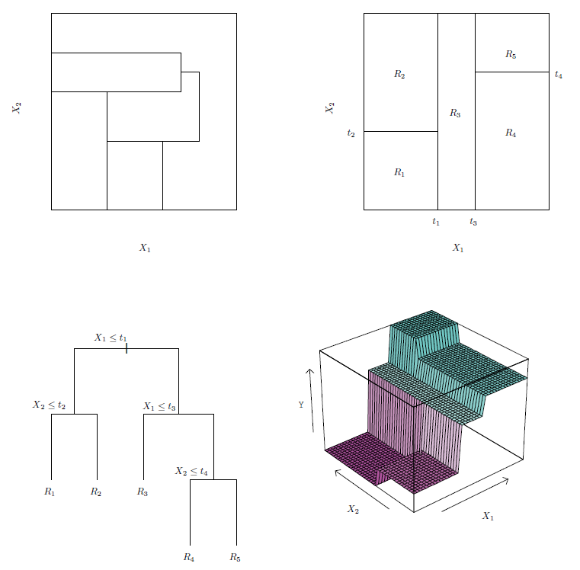
Tree Partitioning of a sub space

Slide 7
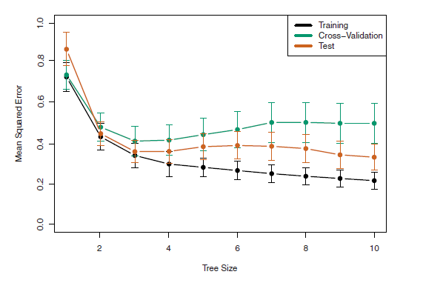
Overfitting with trees
Parameters in trees,
- tree depth
- minimum leaf size
- objective (eg. Error metric)

Slide 8
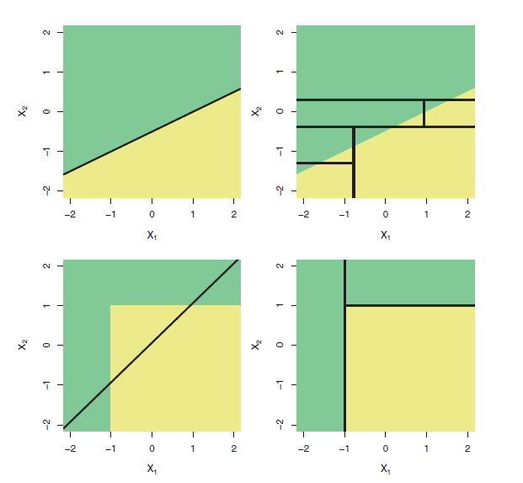
Trees versus Linear models

Slide 9
Thank you!

